Slide 1

Terraform Lifecycle Modernization
A comprehensive program modernizing Terraform lifecycle through AI-assisted governance, documentation, and security—establishing measurable baselines and enabling autonomous operations over time.

Slide 2

PROGRAM OVERVIEW
Business Value & Strategic Outcomes
Faster, Safer Delivery
Policy-Aligned Risk Handling
Automated documentation, consistent module structure, and early security feedback reduce cycle time from development to production.
Findings produce fix PRs or exception drafts pre-filled with required evidence; approvals remain human-led.
Measurable Baseline
Platform for Autonomy
Documentation freshness, module conformance, and security posture are continuously measured and trended.
Once the baseline is enforced, agents can safely take on higher-order tasks like refactoring modules and orchestrating upgrades.

Slide 3

FOUNDATIONS
Operating Principles & Core Capabilities
Operating Principles
Target Capabilities
Automation favors fixes over exceptions
Doc & Schema Bot: generates/updates README, ADRs, and validates module manifests
Humans approve risk decisions; agents assemble evidence and drafts
Dependency graph: auto-PRs to dependents with changelogs and upgrade guidance
Every change updates both human-readable docs and machine-readable manifests
Wiz integration: advisory annotations → enforced gates with exception drafts
Telemetry is first-class: all agent actions are auditable and measured
Dashboards: exceptions, MTTR, documentation freshness, module health
Note: While AI is used for contextual reasoning and recommendations, TFLM is fundamentally schema driven and tooling lead. Deterministic validation, policy enforcement, and human approval remain authoritative.

Slide 4





Implementation Roadmap
Phase 0: Foundations
Standards, schema, manifests, catalog, non-blocking checks
Phase 1: Advisory Automation
Integrate WizCLI, draft fixes/exceptions, training
Phase 2: Enforced Quality Gates
Block on Critical/High, enforce conformance, propagate updates
Phase 3: Autonomous Operations
Dashboards, continuous analysis, expand to Helm, Docker, K8s

Slide 5
METRICS
Key Performance Indicators
14
95%
2.5
8%
Documentation Freshness
Schema Conformance
Security MTTR
Exception Rate
Percentage of modules passing structural checks—indicates standardization progress
Median days to remediate Wiz findings—measures effectiveness of advisory→enforced
Percentage of PRs requiring exceptions—highlights policy gaps or recurring constraints
Days since last auto-update per module—signals staleness and risk of drift
These leading indicators provide continuous visibility into program health and enable data-driven decision making for policy evolution and resource allocation.

Slide 6
Phase 0: Establishing Foundations
Define Terraform Module Schema
Add Module Manifest
Standardize Repository Layout
Create module.json at repo root to declare identity, interfaces, dependencies, and docs locations—enabling automation and global catalog
Create JSON Schema describing required structure: module identity, supported clouds, inputs/outputs, dependencies, docs pointers, and compliance metadata
Establish consistent structure with modules, docs, ADRs, workflows, and schemas directories
Documentation Templates
Non-Blocking CI
Stand Up Catalog
README describes purpose, inputs/outputs, examples, version support, security notes; ADRs record decisions and trade-offs
CI validates schema and posts non-blocking comments—easing adoption without blocking merges
Create terraform-catalog repo with index.json enabling dependency graphing across all modules

Slide 7

PHASE 1
Advisory Automation: Intelligence Without Blocking
Integration & Automation
Integrate WizCLI in PR workflows to provide non-blocking security advisories. Parse results into JSON and post GitHub review comments for each finding with links and remediation guidance.
Automated Responses
For deterministic fixes, the agent opens a sibling PR with HCL changes and a linked plan. When findings cannot be fixed due to constraints, draft exception requests with required fields—approvals remain manual.
Change Management
Run brown-bag sessions on reading annotations, accepting fix PRs, and reviewing exception drafts. Create wiki pages with before/after examples and FAQ.
"Provide PR-time advice without blocking, while drafting fixes or exception dossiers automatically."

Slide 8

Phase 2: Enforced Quality Gates
1
Enable Blocking Conditions
Configure workflow to fail on Critical/High findings unless an approved exception is linked. Turn advisory checks into enforced gates.
2
Enforce Module Conformance
Mark schema validation and docs freshness as required checks. Fail build when manifests or docs are missing or stale.
3
Dependency Graph & Ripple PRs
On module release, query terraform-catalog for dependents and open PRs with version bumps, changelogs, and upgrade notes.
4
Release Governance
Enforce semantic versioning via CI. Require and validate changelog per PR. Run automated upgrade tests for key compositions.

Slide 9
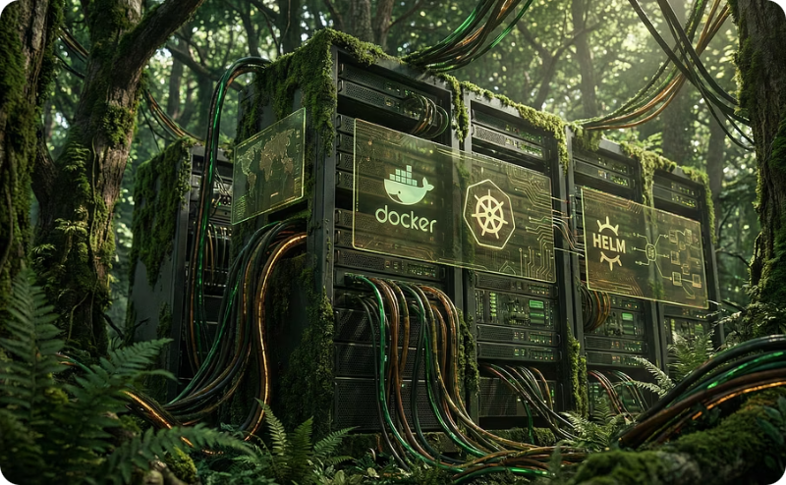


AUTONOMOUS
Phase 3: Autonomous Operations & Expansion
There was an error generating this image
There was an error generating this image
Telemetry & Dashboards
Pattern Mining & Policy Evolution
Expand Asset Coverage
Autonomy with Guardrails
Emit structured events from all workflows. Build dashboards for MTTR, exception half-life, module health, and doc freshness.
Identify recurring exception patterns; convert stable, low-risk patterns into codified policy updates or paved-path modules.
Integrate Dockerfiles, Helm charts, K8s manifests. Standardize common patterns across Azure/GCP/AWS.
Allow agents to refactor modules mechanically behind feature flags. Maintain human approval for risk or behavior changes.

Slide 10
Governance & Implementation Architecture
Governance Framework
Technical Architecture
Reusable td-terraform-safety-check workflow runs on PRs and scheduled cadence. Deterministic core with GitHub Actions + Checks API enforces standards. Optional AI drafts PRs or exception text from normalized artifacts.
Human Authority
Approvals for risk acceptance remain with designated owners; automation only drafts
Scope: Terraform modules across GCP/Azure/AWS, GitHub Enterprise repositories, Actions-based CI/CD, WizCLI for IaC scanning
Traceability
Agent actions must be idempotent, traceable, and reversible with rollback PRs
Code Review
All code changes occur via PR with human review; no direct pushes
The program establishes a foundation for safe, measurable, and increasingly autonomous infrastructure management while maintaining human oversight for critical decisions.

